Slide 1
Employees and the Corporation
Chapter 15
©2020 McGraw-Hill Education. All rights reserved. Authorized only for instructor use in the classroom. No reproduction or further distribution permitted without the prior written consent of McGraw-Hill Education.

Slide 2
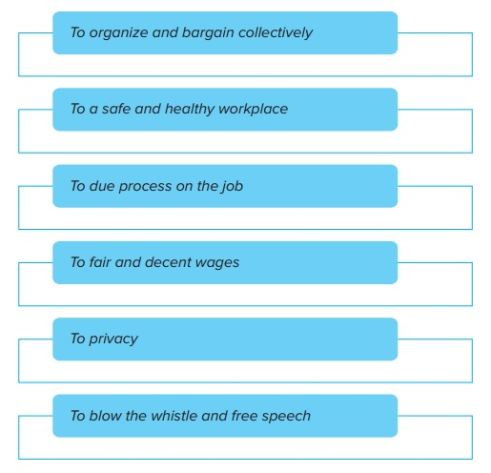
Major Rights of Employees
Copyright © McGraw-Hill Education. Permission required for reproduction or display.
Figure 15.1
Access the text alternative for these images.
Notes:
Employees are an important market stakeholder:
Responsible for carrying out the work of the company.
Dependent on the employer for their livelihood.

Slide 3

Workplace Rights
Employees in the United States enjoy important legal guarantees. They have the right to:
  Organize and bargain collectively.
  A safe and healthy workplace.
  Due process.

Slide 4

Right to Organize and Bargain Collectively1
Employees have a fundamental legal right to organize labor unions and to bargain collectively with employers.
Influence of labor unions has varied during periods in U.S. history
Although unions overall remain weak, some groups of workers continue to organize.
Notes:
Employees have a fundamental legal right to organize labor unions and to bargain collectively with employers.
Workers have a right to hold an election to decide which union will represent them.
Labor unions: Organizations that represent workers on the job.
Labor unions have the right to negotiate wages, working conditions, and other terms of employment.
Employers are required to bargain with unions in good faith.
If agreement cannot be reached, a strike might occur.
Influence of labor unions has varied during periods in U.S. history:
In 2017, the median weekly pay of full-time workers who were members of unions was 20 percent higher than that of nonunion workers.
In 2017, only about 11 percent of all U.S. workers were union members.
The percentage was higher, 34 percent, in government employment.
In the private sector, just 7 percent were unionized.
In the wake of the Great Recession, elected officials in several states sought to weaken unions by limiting the rights of public sector workers.
→ Example: In 2017, Missouri joined 27 other states in adopting a right-to-work law.
Although unions overall remain weak, some groups of workers continue to organize.
Example:
Cleveland water workers joined the Utility Workers Union of America (UWUA).
A major legislative goal of unions is labor law reform:
Legislation that would make it easier for workers to organize.
Examples:
Shortening the time before an election.
Stiffening penalties for employers who intervene unfairly in the election process.

Slide 5
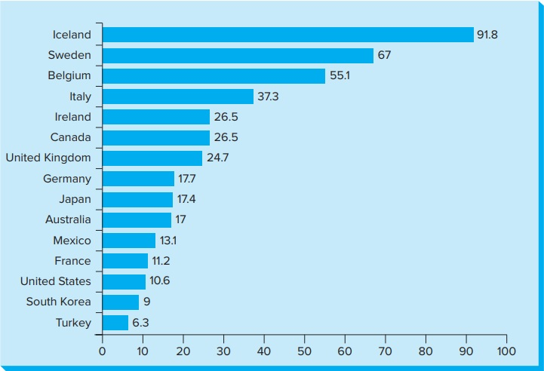
Unionization Rates in Selected Industrialized Countries
Figure 15.2
Copyright © McGraw-Hill Education. Permission required for reproduction or display.
Access the text alternative for these images.

Slide 6

The Right to Safe and Healthy Workplace
Annually, slightly more than 3 million workers are injured
Occupational Safety and Health Act
Notes:
Annually, slightly more than 3 million workers in private industry are injured or become ill while on the job (U.S. Department of Labor).
Compare to compensation in Canada
Occupational Safety and Health Act, passed in 1970, gives workers the right to a job “free from recognized hazards that are causing or likely to cause death or serious physical harm.”
This law is administered by the Occupational Health and Safety Administration (OSHA).
Since the agency’s creation in 1970 the overall workplace death rate has fallen by more than two-thirds.

Slide 7
Job Security and the Right to Due Process1
Since late 1800s, the legal basis for the employment relationship has been employment-at-will.
Many union contracts say employees can be fired only “for just cause,”
Notes:
Since late 1800s, the legal basis for the employment relationship has been employment-at-will.
Employment-at-will is a legal doctrine that means employees are hired and retain their jobs “at the will of” (i.e. at the sole discretion of) the employer.
However, equal employment opportunity and other laws prevent discriminatory terminations.
Many union contracts say employees can be fired only “for just cause,” and workers have a right to appeal the employer’s decision through the union grievance procedure.
European countries and Japan have laws that extend “just cause” protections to all workers (not only for union members).
Cultural values, traditions, and norms of behavior also play important roles.
Social contract: the implied understanding between an organization and its stakeholders. This is not a legal contract, but rather a set of shared expectations.

Slide 8
Wages and Income Inequality1
What responsibility if any does business bear for the sharp differences in life circumstances between those at the top and bottom of society?
What is the relationship between inequality and wages?
How should wages be determined? What is fair?
Notes:
Share this also
In 2016, about 45 million U.S. “gig workers” offered a product or provided services requested by a “peer” via online “platforms.” Gig workers are independent contractors, online platform workers, contract firm workers, on-call workers and temporary workers.
About a third of gig workers use this type of work for 40 percent or more of their income.
Some legislators have expressed concern that this type of employment arrangement can burden welfare and unemployment services if the gig does not pay enough to live on.
→ Example: Postmates’ workers filed a lawsuit claiming they were deliberately misclassified as independent contractors, rather than employees.

Slide 9
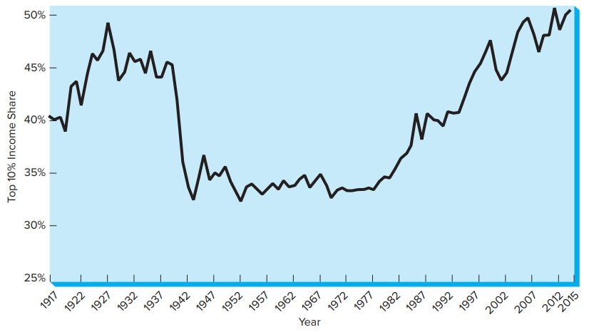
Income Inequality in the United States,
1917-2015
Figure 15.3
Copyright © McGraw-Hill Education. Permission required for reproduction or display.
Access the text alternative for these images.

Slide 10
Wages and Income Inequality2
What can companies do to address income inequality?
  Increase wages of their employees.
  Reduce pay differentials within their organizations.
Notes:
What can companies do to address income inequality?
Increase wages of their employees.
Reduce pay differentials within their organizations.
Living wage: Wage “that enables workers, for their labor during a standard work week, to support half the basic needs of an average-sized family, based on local prices near the workplace” (Ethical Trading Initiative).
Companies that adopt such a “good jobs” strategy reap benefits from doing so.

Slide 11
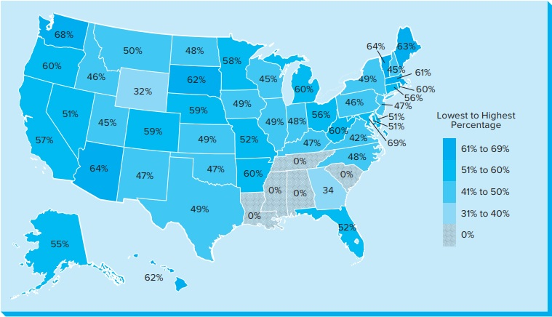
Percentage of Living Wage Covered by Minimum Wage
Figure 15.4
Copyright © McGraw-Hill Education. Permission required for reproduction or display.
Access the text alternative for these images.
Notes:
Instructor note: The lines pointing at the District of Columbia and Maryland are reversed in the image. DC=69% and MD=51%.

Slide 12
Percentage of Living Wage Covered by Minimum Wage
Text Alternative
A color-coded key indicates the percentage level and includes these categories from darkest to lightest: 61 to 69 percent; 51 to 60 percent; 41 to 50 percent; 31 to 40 percent; and 0. Per state, the data reads as follows: Alabama at 0 percent. Louisiana at 0 percent. Mississippi at 0 percent. South Carolina at 0 percent. Tennessee at 0 percent. Wyoming at 32 percent. Georgia at 34 percent. Virginia at 42 percent. Utah at 45 percent. New Hampshire at 45 percent. Wisconsin at 45 percent. Pennsylvania at 46 percent. Idaho at 46 percent. New Mexico at 47 percent. Oklahoma at 47 percent. New Jersey at 47 percent. Kentucky at 47 percent. North Carolina at 48 percent. North Dakota at 48 percent. Indiana at 48 percent. Iowa at 49 percent. New York at 49 percent. Kansas at 49 percent. Texas at 49 percent. Illinois at 49 percent. | Montana at 50 percent. Delaware at 51 percent. Maryland at 51 percent. Nevada at 51 percent. Missouri at 52 percent. Florida at 52 percent. Alaska at 55 percent. Ohio at 56 percent. Connecticut at 56 percent. California at 57 percent. Minnesota at 58 percent. Nebraska at 59 percent. Colorado at 59 percent. Oregon at 60 percent. Rhode Island at 60 percent. Michigan at 60 percent. West Virginia at 60 percent. Arkansas at 60 percent. Massachusetts at 61 percent. Hawaii at 62 percent. South Dakota at 62 percent. Maine at 63 percent. Vermont at 64 percent. Arizona at 64 percent. Washington at 68 percent. District of Columbia at 69 percent.
Return to slide containing original image.

Slide 13

Privacy in the Workplace
Privacy Rights
Electronic Monitoring
Romance in the Workplace
Notes:
An important right in the workplace as elsewhere, is privacy.
Privacy rights: primarily protecting an individual's personal life from an unwarranted intrusion by the employer.
Key workplace issues where privacy dilemmas often emerge include electronic monitoring, office romance, drug and alcohol abuse, and honesty testing.
Electronic Monitoring
New technologies enable companies to gather, store, and monitor information about employees’ activities.
A company’s need for information, particularly about its workers, may be at odds with an employee’s right to privacy.
Management justifies the increase in employee monitoring for a number of reasons:
Employee efficiency.
Fear of lawsuits if employees act inappropriately.
Example: Sociometric Solutions makes sensor-rich badges.
Romance in the Workplace
Issue requires careful balancing between legitimate employer concerns and employee privacy.
A 2017 survey – 57 percent of workers said they had participated in some type of office romance.
The #MeToo and #TimesUp movements have changed many peoples’ perception of workplace romance.
43 percent of employees surveyed in 2018 thought relationships between colleagues at different levels was unacceptable (up sharply from the year before).

Slide 14

Privacy in the Workplace:
Employee Drug Use and Testing
Alcohol Abuse at Work
Employee Theft and Honesty Testing
Honesty Testing Controversy
Notes:
Drug and alcohol testing:
Drug abuse costs U.S. industry and tax payers an estimated $193 billion a year.
Drug-Free Workplace Act (1988) – required federal contractors to establish and maintain a workplace free of drugs.
Drug testing is typically used on three different occasions:
Pre-employment screening.
Random testing of employees.
Testing for cause.
Alcohol use and addiction causes twice the problems of all illegal drugs combined.
About 9 percent of full-time employees are heavy drinkers.
Up to 40 percent of all industrial fatalities and 47 percent of industrial injuries are linked to alcohol.
U.S. businesses lose an estimated $88 billion per year in reduced productivity directly related to alcohol abuse.
Employee Assistance Programs (EAPs): offer counseling, rehabilitation programs, and follow up.
Employee Theft and Honesty Testing
Employee theft has emerged as a significant economic, social, and ethical problem in the workplace.
A 2015 survey of large retail stores in the United States showed that almost 30 percent of all inventory losses were due to employee theft.
The retail value of goods stolen by employees was more than $15 billion.
Honesty Testing Controversy
Some companies use written psychological tests to predict employee honesty.
American Psychological Association notes these tests can generate false positives.
→ Example: Test predicts employee would probably steal from the company, even though this is untrue.
Tests may intrude on a person’s privacy and discriminate disproportionately against minorities.

Slide 15


Whistle-blowing and Free Speech in the Workplace1
Free speech in the workplace
Whistle-Blowing
Whistle-blowing – Laws
Conditions for whistle-blowing
Notes:
Free speech in the workplace:
U.S. Constitution protects free speech; however, does not specifically protect freedom of expression in the workplace.
Employees are not generally allowed to speak out against their employers, due to legitimate interests of the business.
Whistle-blowing: when an employee believes his/her employer has done something that is wrong or harmful to the public, and he/she reports the alleged misconduct to the media, government, or high-level company officials.
Whistle-blowing – Laws
Sarbanes-Oxley Act, passed in 2002:
Makes it illegal for employers to retaliate in any way against whistle-blowers who report information that could have and impact on the value of a company’s shares.
Dodd-Frank Act of 2010:
Requires the government to pay a reward to whistle-blowers who voluntarily provide information that leads to successful prosecutions for violations of federal securities laws.
U.S. False Claims Act 1986 (Lincoln Law):
Allows individuals who sue federal contractors for fraud to receive up to 30 percent of any amount recovered by the government.
Four conditions must be satisfied to justify whistle-blowing:
Organization is doing (or will do) something that seriously harms others.
Employee has tried and failed to resolve the problem internally.
Reporting the problem publicly will probably stop or prevent the harm.
The harm is serious enough to justify the probable costs of disclosure to the whistle-blower.

Slide 16
End of Main Content
Notes:
Closing slide.

